Slide 1
Marine parasites and fish

Slide 2
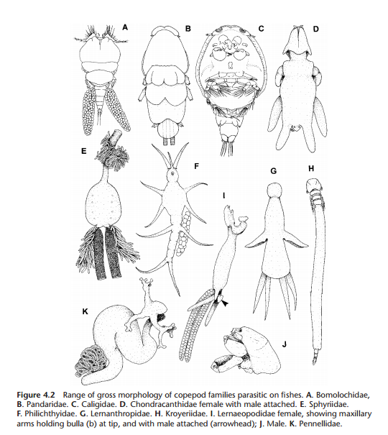
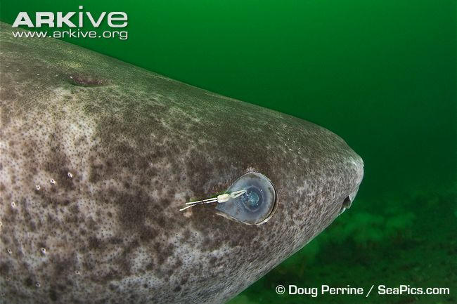
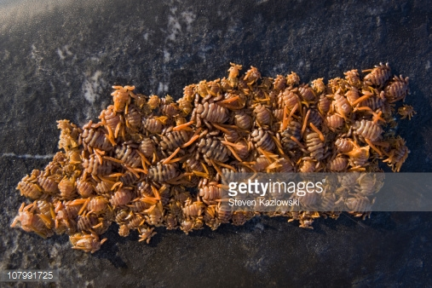
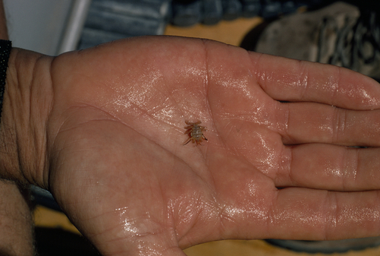
Copepods
Type of crustacean
Lives on outside of fish
Hoeg et al. 2005
www.natgeocreative.com

Slide 3
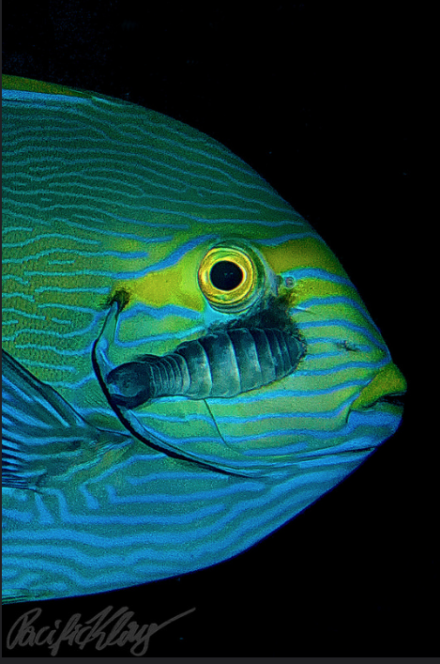
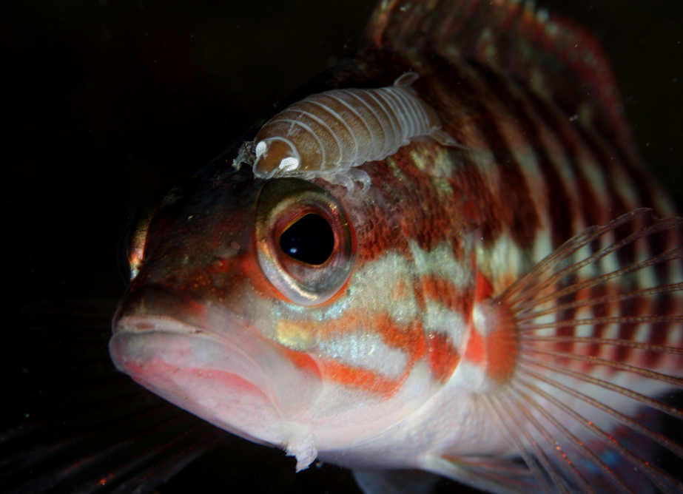
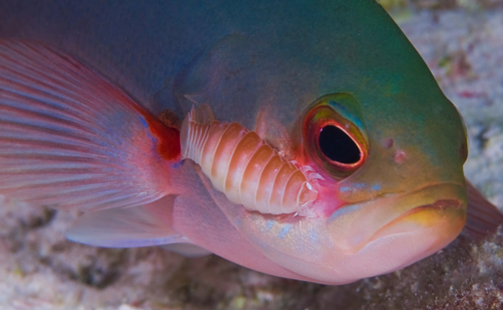
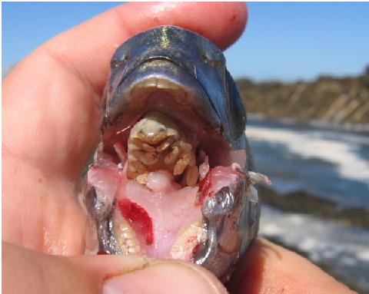
Isopods
Type of crustacean
Lives on outside of fish
Klaus Stlefel
Joao Pedro Silva
www.uj.ac.za
Notes:
https://www.flickr.com/photos/pacificklaus/15875619187/in/photolist-qbSGuc-8z3CEE-dLHwL2-qoa1vd-7LfQgT-ntx9h3-a1F7Vc-7LfPZg-niJB4m-5GySNS-8z3AA1-pteCyQ-nKqcSi-nEJPtr-QEKUha-QEKBfz-ibxSD3-66nYuK-oQfAFC-pLJRHH-8opSTt-96azbr-7LfQ5V-945Tqv-f8FvKS-7LjP15-7A8YC9-3pEL2y-nJeUTW-9bUo7E-cL5bTh-dB8LwM-hT3NMU-bqa7TM-p1U8xs-R3XYmD-prdE9C-a7er-6h37PU-cecKaQ-G8kWD3-6DsD5b-96azig-nnXrFQ-7ruQr1-o1wgCL-94u5d1-qgVMnp-9ycbvi-od3cYc
https://www.flickr.com/photos/jpsilva1971/6353862143/in/photolist-aFteeD-ajtxxj-cyZMXf-5BCAP6-cYEFBf-avc3Ea-gMXZvp-6xpx7h-aji4E3-gMX2ZL-9Agk5Y-fAEtrq-bnNset-atVR1E-riKSG1-8ZWtFV-9o4GM4-gMYK7d-767D71-qFPMD8-aFtdtc-abLH6F-cNwjVs-aFtcRi-gMWrHv-amHwnk-akqCXm-6xknze-gMZNKH-ar3qv5-FkpXQZ-9o7Lno-frXK8R-N3Lx9r-RBcZGy-REqBGs-a3WX5z-bmT12U-bmT16L-Rg1uZw-7n4hgF-SYogBw-rwTjE9-9czTWG-s5SXF7-acNbuC-9cyUMk-9MgLnk-JqwrSe-9p1L7Y/

Slide 4
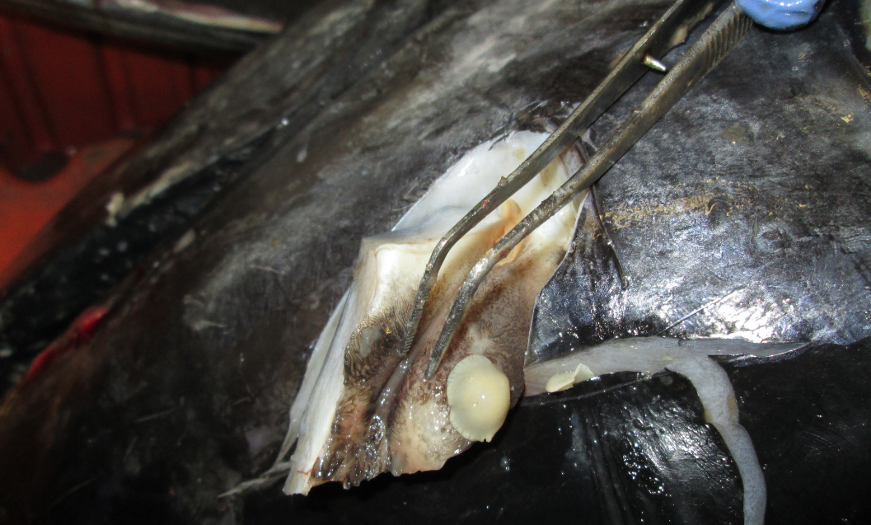
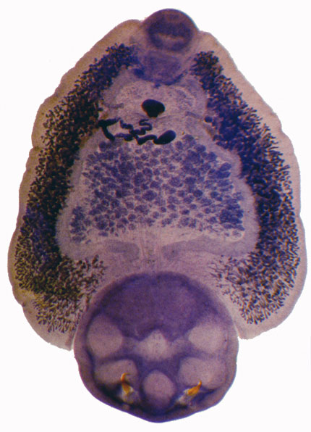
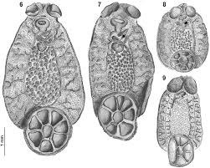
Monogeneans
Flatworm
Attaches to host with a sucker
www.aquaticparasitologylab.org
Notes:
http://www.samuseum.sa.gov.au/research/biological-sciences/parasites/1160

Slide 5
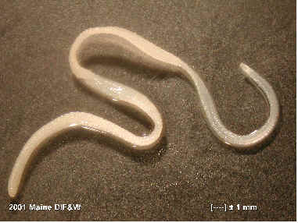
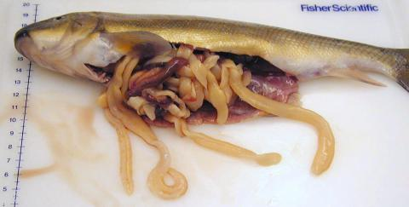
Cestodes
Flatworm
Infect fish intestines
www.maine.gov
Notes:
http://www.maine.gov/ifw/fishing/health/vol4issue1.htm
https://fishpathogens.net/pathogen/lingula-intestinalis

Slide 6
Importance of marine parasites to humans
Can make the fish we love to catch and eat sick
Can kill fish
Can make fish look gross so that we don’t want to eat them
Can be dangerous to eat infected fish

Slide 7
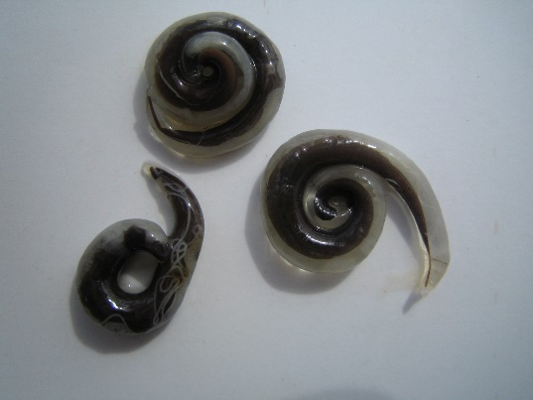
OPERATION:
NASTY NEMATODE
TOP PRIORITY

Slide 8
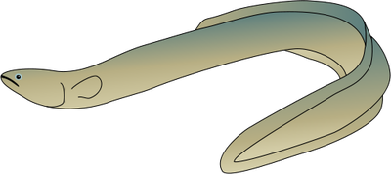
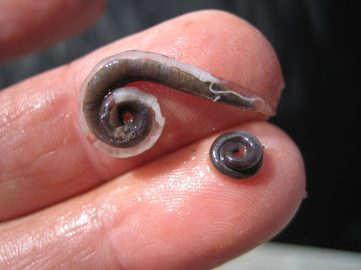
American eels and nasty nematodes
American Eels
Parasitic nematode
?
Declining eel population?
Notes:
This is the example that the activity is based off. The activity will simulate the sampling of the eels for the parasite and a simple analysis of the data.

Slide 9
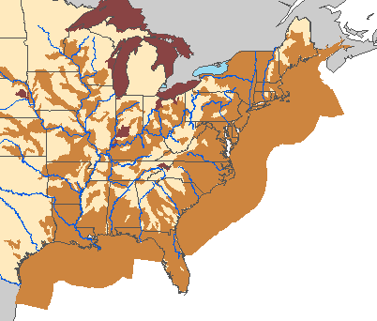
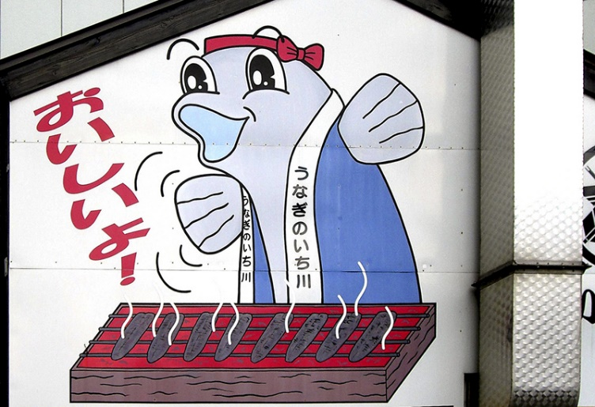
= American eel range
= nematode range
>80 % prevalence
Notes:
The nematode is originally from japan where it infects the Japanese eel, but was introduced to the US in the early 1990 and since has spread throughout the American eel range. Some areas have over 80% of the eels infected.

Slide 10
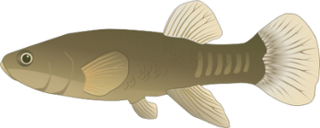
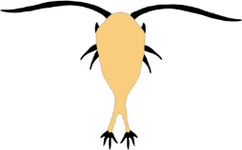
Nematode life cycle
Notes:
This nematode is trophically transmitted, meaning eels become infected when they eat infected prey. Parasite eggs are released from the eel with its feces and are eaten by some types of zooplankton (copepods, ostracods), which are the intermediate host. These zooplankton can then be eaten by the eels or eaten by other aquatic species such as other fishes, amphibians, insect larvae, and snail, which can also be eaten by the eels. Once inside the eel, the nematode infects the eel’s swimbladder, which is an air-filled organ, kind of like a balloon, that the eels use to control their buoyancy and help them swim. The nematodes can cause so much damage to the swimbladder that it is no longer a functioning organ.

Slide 11
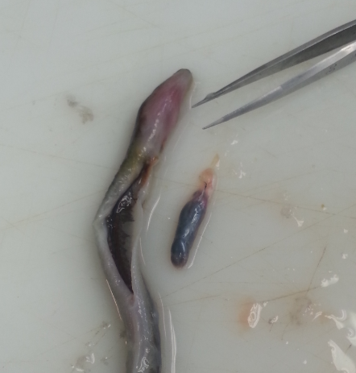
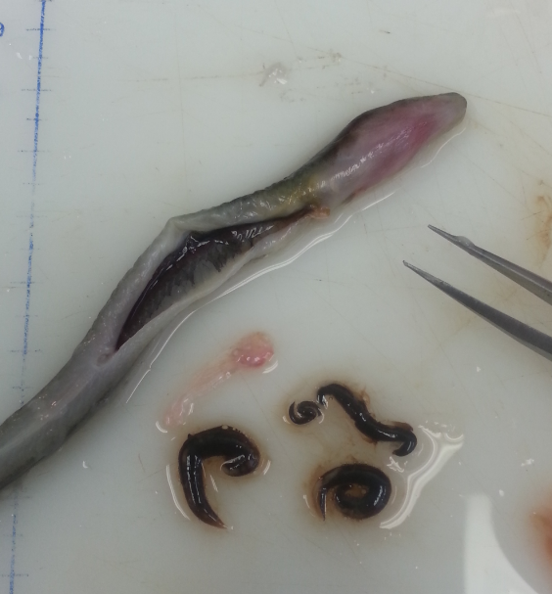
Effects on eels:
Severe damage to swimbladder
Negatively affects swimming, metabolism, immune system
May affect ability to avoid predation, fishing pressure, hydraulic dams
May impair reproduction
Swimbladder containing parasites
Swimbladder with parasites removed
Notes:
Keep this for intro, second slide

