Slide 1
Tidal wetlands

Slide 2
Today’s Objectives
After this lesson, you will be able to:
Explain the importance of different types of wetlands
Describe where you might find different types of wetlands
Demonstrate the services provided by wetlands
Assess the current challenges that wetlands face

Slide 3
What is a wetland?
Wetland – areas inundated or saturated with water most or all of the time
Under normal circumstances, wetlands support vegetation and wildlife adapted to living in water and saturated soils
A. Knobloch

Slide 4
What’s an example of a wetland?
Salt marsh
Mangrove
Freshwater marsh
Swamps
Fens
Bogs
Notes:
Discussion slide- Questions to ask:
What’s an example of a wetland? Where can I find one?

Slide 5
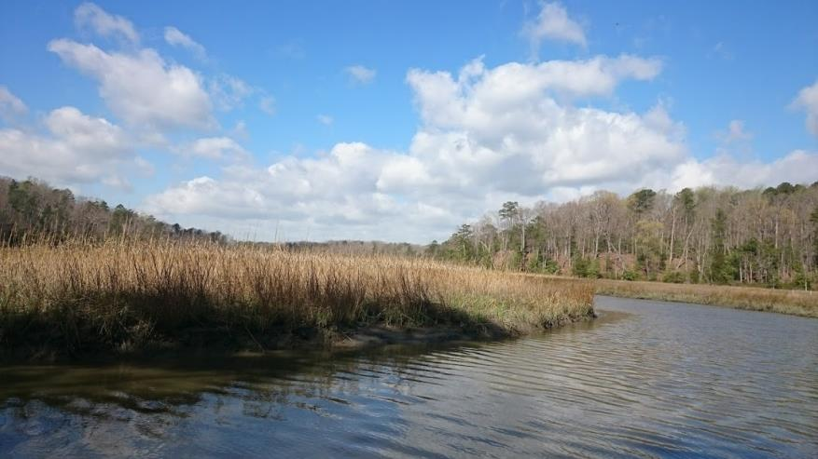
What are some different types of wetlands?
Salt marshes
Freshwater marshes
Mangroves
A. Knobloch

Slide 6
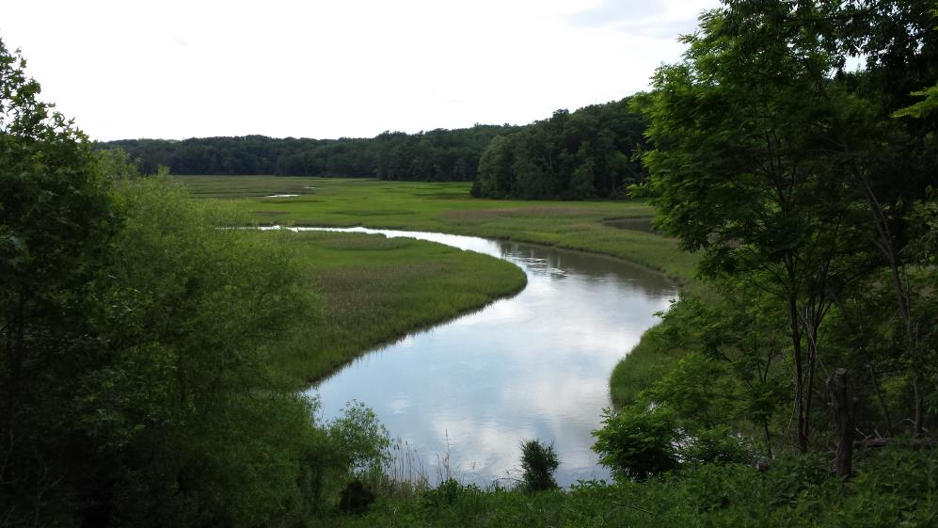
Salt Marshes
Occur worldwide
Tidal zone in between land and open saltwater
Plant life dominated by marsh grasses
High primary productivity
Habitat for >75% of
fisheries species
Blue crab
Shrimp
Finfish
A. Knobloch

Slide 7
Freshwater Marshes
Located upstream of saltwater marshes
Close enough to the sea that tides still influence them, but not close enough that saltwater can affect them
All plants here are intolerant to salt
A. Knobloch

Slide 8
Mangroves
Found in tropics/subtropics
3 main types (red, black, white)
Salt tolerant trees
Can remove salt from water
Complex root system
Habitat for billions of worms, protozoa, barnacles, oysters, and other invertebrates
Feed fish & shrimp which feed wading birds, pelicans, & crocodiles
Notes:
, adapted to live in harsh coastal areas

Slide 9
Since the 1700s, the US has lost over 50% of its wetland resources
What’s going on?

Slide 10
Stressed out wetlands
Natural stressors
Storm events can damage or destroy wetlands if they are strong enough
Even though wetlands can buffer storms, if a storm is too strong or too long, it can severely damage a wetland
A. Knobloch

Slide 11
Stressed out wetlands
Human stressors
Damming
Wetlands need a supply of sediment to keep forming new area and keep up with sea level rise
Damming traps sediment that would normally go to a wetland
Mangrove Deforestation
Mangroves are being cut down for agriculture, urban areas, forestry, and warfare
A. Knobloch

Slide 12
Stressed out wetlands
Human stressors
“Shoreline squeeze”
During sea level rise, wetlands can grow taller by accumulating more sediment or they can move inland by taking over newly wet ground
If there is a wall or bulkhead there, the wetland cannot move inland
Excess nutrients
Increased fertilizers/nutrients → increased aboveground plant growth → decreased root growth → creek banks collapse due to lack of structure from roots
Notes:
We build these to protect our own property, but it leads to the destruction of wetlands, which naturally protect our property. So are they worth it?

Slide 13
Stressed out wetlands
Climate change
Sea level rise
Normally, with enough sediment, wetlands can keep pace with sea level rise
Without enough sediment supply, or in times of very fast sea level rise, wetlands can be overcome by water levels and drown
A. Knobloch

Slide 14
What can we do to help wetlands?

Slide 15
Conservation efforts
Restoring water paths
Restoring degraded wetlands
Creating new wetlands
Enhancing current wetlands
A. Knobloch

Slide 16
Why do we want to protect wetlands?

Slide 17
Why are wetlands so important?
Flood control
Clean Water
Food supply
Shoreline and storm protection
Cultural value
Materials & medicines
Recreation areas
Refuge for migrating birds
Vital habitat
Notes:
Discussion slide- Questions to ask:
What’s an example of a wetland? Where can I find one?

Slide 18
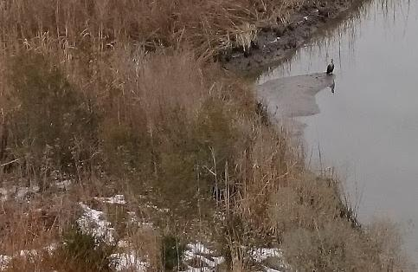
Wetland Services – habitats
Large variety of wetland habitat types
Each habitat can support a different group of species
Migratory birds use them as “pit stops” on long journeys
A. Knobloch

Slide 19
Wetland Services – Storm Protection
Act to slow down inland movement of storm surges
Storm surge = the bulge of water formed by wind and low pressure of a strong storm
When storm surge hits a wetland, it encounters some resistance moving over the wetland.
Resistance can reduce the height of the surge and waves and slow the movement of water
The wider the wetland buffer, the higher the level of protection!
After Hurricane Ike in Texas in area where wetlands have been replaced by beach houses
A. Knobloch
Notes:
Prevent shoreline erosion by buffering wave action and trapping sediments
Reduce flooding by slowing and absorbing rainwater

Slide 20
Wetland Services – Water Filter
Can act as a filter to remove excess fertilizers and contaminants
Fertilizers = nutrients
Some wetland plants can use these nutrients to grow
Toxins can be buried in sediments
A. Knobloch
Notes:
Protect water quality by filtering runoff and metabolizing excess nutrients

Slide 21
Blue Carbon
Blue carbon = carbon that is stored in the soils of wetlands
Short term storage – plant biomass (leaves, roots, trunks)
Long term storage – soils
Approximately half of the atmospheric carbon is taken up by living organisms
About half of this carbon is stored as “blue carbon” in wetlands
If wetlands are lost, all of this carbon will escape back into the atmosphere…

Slide 22
Cost of a Beach House

Slide 23
Build your wetland
What services do wetlands provide?
What parts of the wetland provide these services?
How can you demonstrate these services?

